Slide 1
Women with disability rehabilitation project proposal
By Dr. Etsegenet T.
Jan 13,2023
Addis Ababa

Slide 2
Background
Urban low-income communities face immense challenges in accessing nutritious food. One of Africa’s biggest cities and Ethiopia’s capital, Addis Ababa, shares this struggle.
A fifth of its residents live in poverty and now face high inflation and cost of living rates that make access to healthy food a daily challenge.

Slide 3
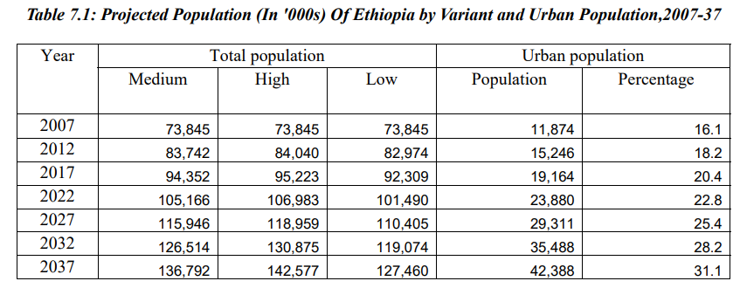
Population growth forecast (CSA)

Slide 4
Disability status
Based on data from UNICEF's 2018 survey, it is estimated that 7.8 million people in Ethiopia are living with some form of disability, which is approximately 9.3 percent of the country's total population.
People With Disabilities are the most neglected, abandoned, marginalized, and disadvantaged citizens, who have lost self esteem and respect as the result of dully recognized physical disability.
Thus, empowering women with disability with agriculture related entrepreneurial and business planning skills to make them more independent and capable to participate in the local economy is a sure way of fighting the extreme poverty observed in the disabled women community.

Slide 5
Objectives of this proposal
Provide skill training and capacity building to support disadvantaged, marginalized and forgotten disabled women in Lemi-kura sub –city
Provide training for 60 women with disability (WDs) or women with a disabled child in poultry rearing in three phases
Provide materials, technical and psycho-social support, to enable trainees engaged in self-supporting income generating activities;
Provide start up capital for the business
Create market linkages for poultry products (egg, chicken, etc)
Promote disability inclusive development through awareness raising.

Slide 6
Proposal concept summery
1) Provision of inputs and trainings – smart cages , 45 days Sasso breed female pullets , provide feed until they start laying eggs
2) Creating market access and links – women's saving groups, peer discussion groups , linking to nearby hotels, supermarkets, caterings
3) Expanding the business – to pullet producers , other businesses

Slide 7
Cyle of the activity
The whole process takes two years for a given HH to be come self- sufficient
45 days dual purpose chicken------> laying hens (1.5yrs) ------>
changing feed to gain wait and sell for meat ------->
get other pullets by themselves---------> continues the cycle
4mo
1.5 yr
2 mo

Slide 8
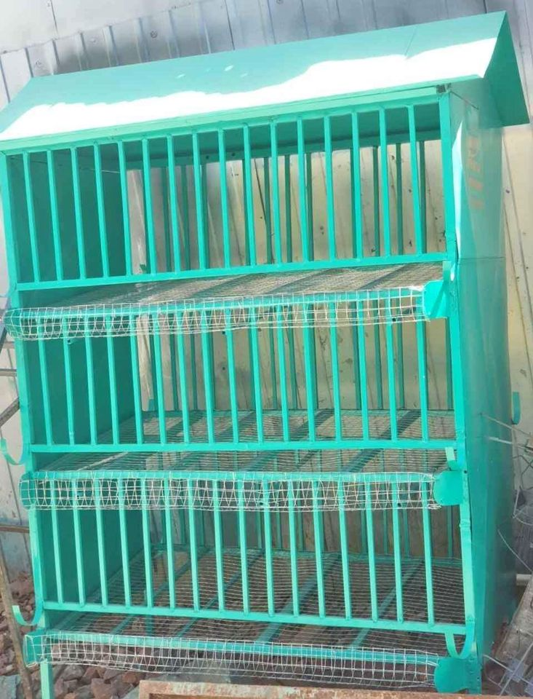
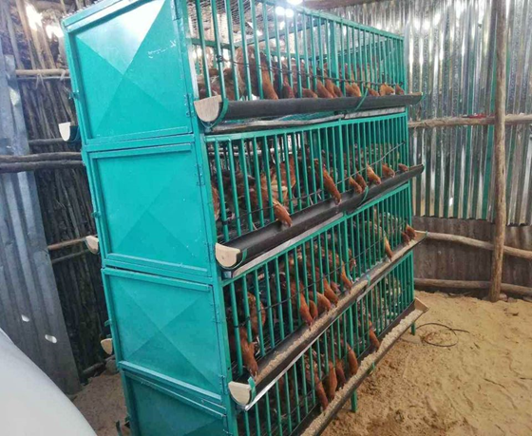
Smart cages that can carry up to160 chickens

Slide 9
Advantage /why women with disability/
Requires minimum mobility
Climate smart businesses
urban agriculture era
High protein demanded due to expanding urban middle class popn.
Easy market access and links (both product and by products)
Can be expanded easily
Consider forgotten/or excluded community –thus high govt support
Gender sensitive
Disability inclusion
Income generating + food security at HH level
Developmental project

Slide 10
Business model
Trainings and stakeholders meeting
Women engaging in Income generating activity (IGA)
Income generation
-enturpruener skill
-Poultry production skill
-Psycosoicla support
-linking women to food markets
-encourage savings
-keeping the cycle going on its own as an exit strategy
Provision of initial capital, follow up of implentation

Slide 11
Project implementation phases
Phase one |  |  | Phase two |  |  | Phase three |  |  | Evaluation
 | Jan-June 2024 |  |  | July –Dec 2024 |  |  | Jan –June 2025 |  |  | July –xxx 2025
Project launch - 20 women enrolled – 1/3 of the budget required - most of the lobbying and MoU signing with govt done |  |  | - 20 women enrolled – 1/3 of the budget required |  |  | - 20 women enrolled – 1/3 of the budget required |  |  | Project outcome evaluation, audit ,closeup

Slide 12
Activity and budget
The over all project activity during the 18 moths implementation time is 8.8 million ETB or ----- Euro

Slide 13
Risk assessment matrix
Risk | Likely hood (low, ,medium, high) | Impact (Fatal, Serious, manageable) | Mitigation strategy
Cost of inputs raising | High | Serious | Looking for cost effective ways, early implementation , reducing the beneficiary number, looking further sponsorship
High expectation of beneficiaries | High | Manageable | Creating awareness and providing psychosocial support on dependency syndrome
Disease outbreaks | High | Fatal | Introducing biosecurity measures, vaccinations
Beneficiaries dropout | Medium | Manageable | Creating strong women’s saving group and competitive incentives
Scarcity of space for the activity | High | Manageable | Apply serious selection criteria of beneficiaries , asking the municipality for land /space
Government employes abusing the quota | Medium | Serious | Creating a clear and measurable goals , cross-checking beneficiaries background for any relation , medical certification
Unavailability of fund | Low | Fatal | Trying different grants

Slide 14
Thank you.

